Slide 1
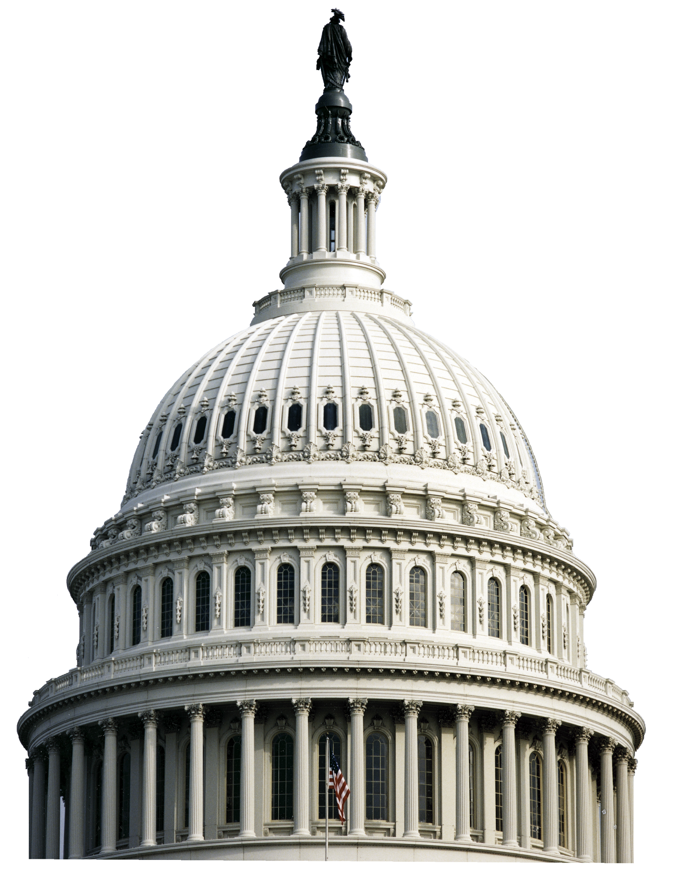

7th District Progress Meeting
Danielle Eckert
Director, Government Affairs Department
IBEW

Slide 2
Roadmap
Butch Lewis Emergency Pension Plan Relief Act
Legislative Updates
Biden’s Build Back Better Agenda
  Bipartisan Infrastructure Framework
  Budget Reconciliation Package
Labor Updates
Political Forecast
The New PAC System
IBEW Action Website
Political Monthly Newsletter

Slide 3
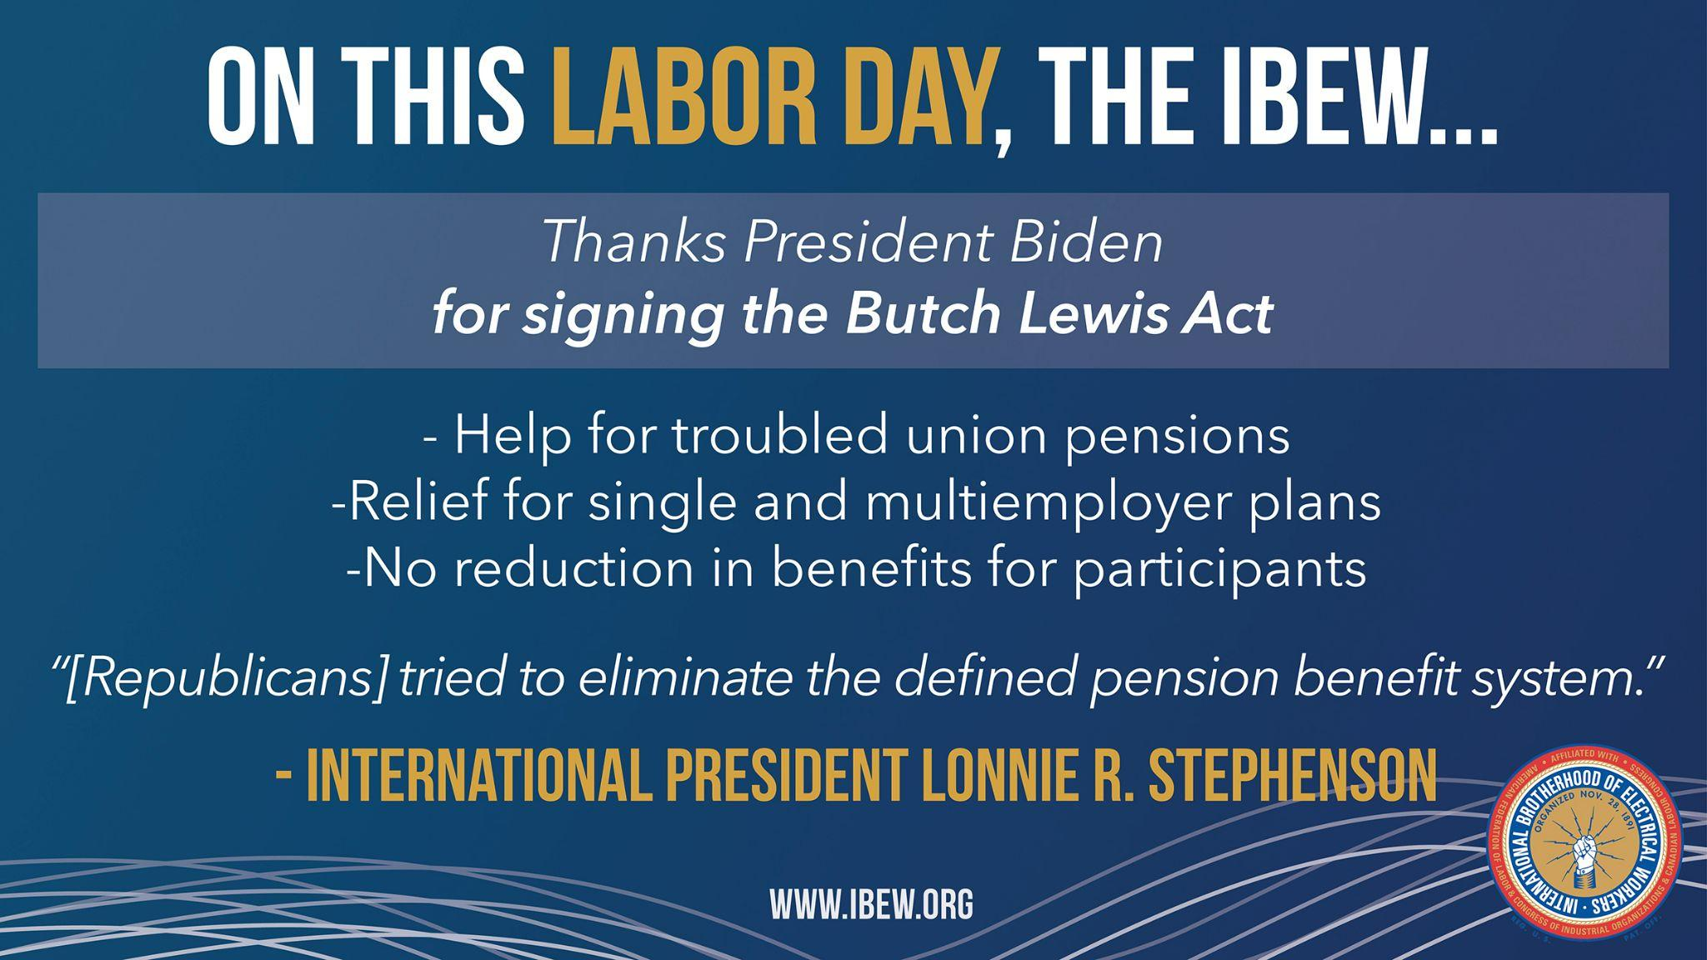
President Biden signed the Butch Lewis Emergency Pension Plan Relief Act on March 21

Slide 4
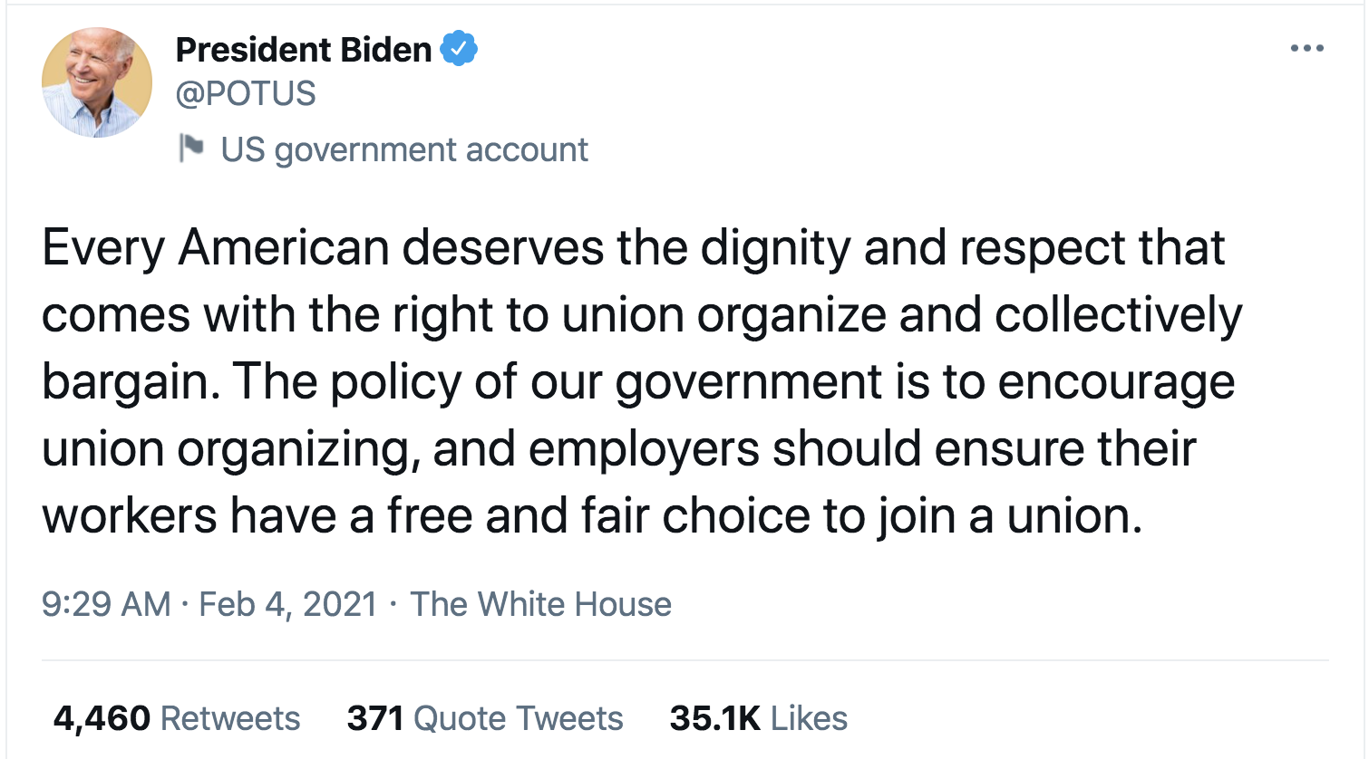
Joe Biden: Most Pro-Union President in History

Slide 5
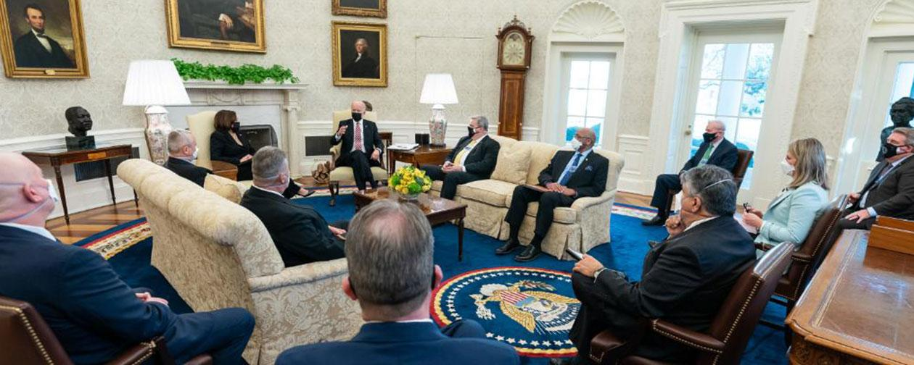
IBEW’s Agenda Matters to President Biden
On the agenda
Infrastructure legislation
Apprenticeship initiatives (rescinding IRAPs)
Retirement security
Domestic manufacturing

Slide 6
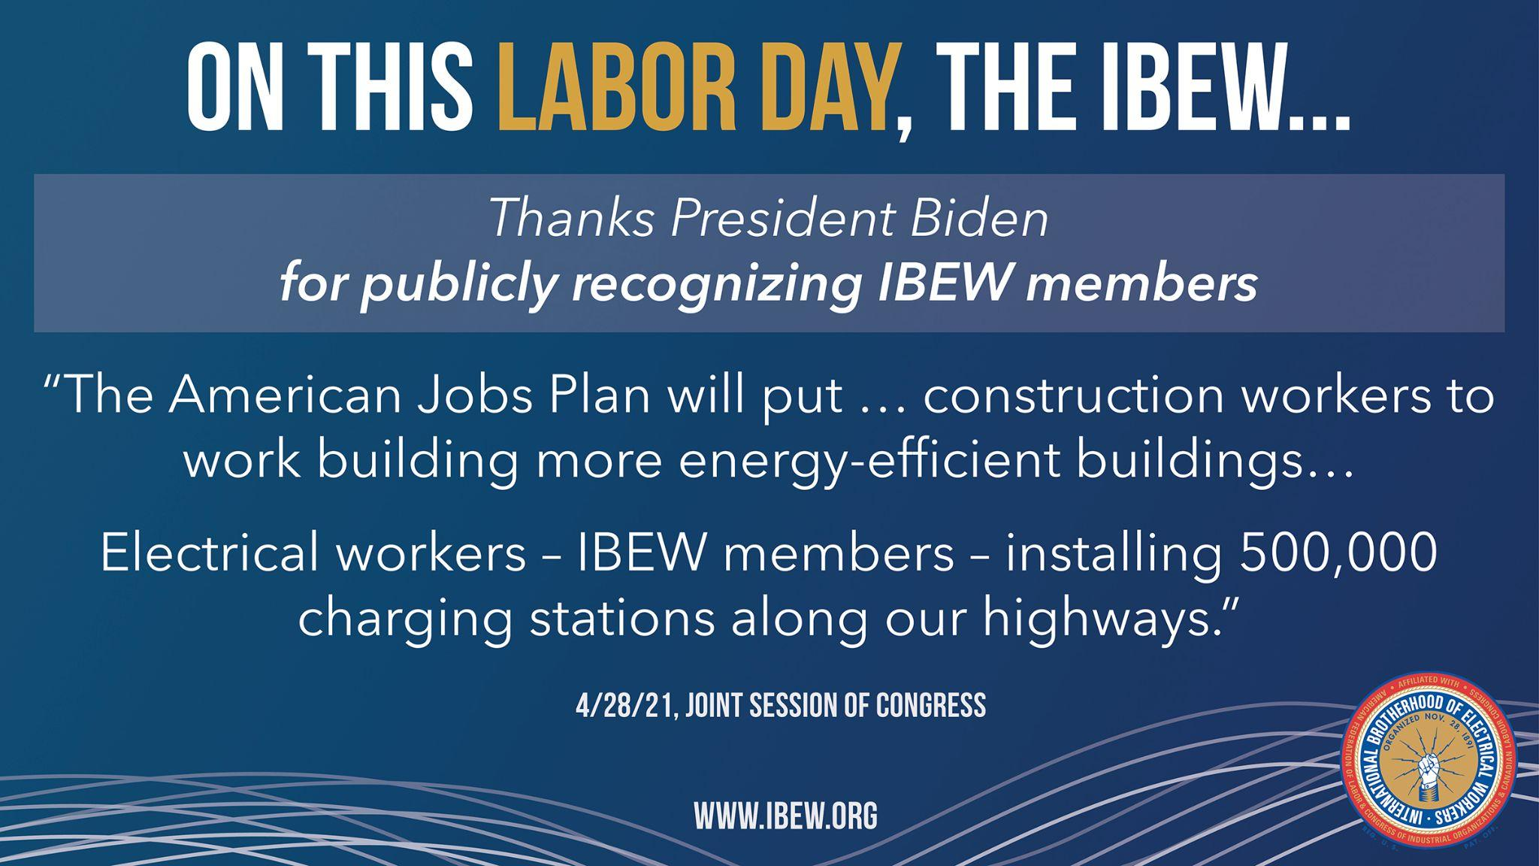
President Biden Promotes IBEW Skills, Professionalism

Slide 7
Build Back Better Agenda
Bipartisan Infrastructure Framework
  $1T in “Hard Infrastructure” or “Traditional Infrastructure” investments
Budget Reconciliation
  $3.5T package that requires special rules to overcome a filibuster
    Contains “human infrastructure”

Slide 8

Bipartisan Infrastructure Framework (1/2)
On August 10, the Senate approved the Infrastructure Investment and Jobs Act in a 69-30 vote and now sends the bill to a divided House of Representatives
OVERVIEW OF THE INFRASTRUCTURE INVESTMENT AND JOBS ACT
Authorizes nearly $550 billion in new federal money for infrastructure projects, as well as to renew existing programs that were set to expire in September.
  $110 billion for roads, bridges, and other major projects
  $73 billion to update the nation’s electricity grid
  $66 billion for passenger and freight rail
  $65 billion for broadband internet
  $55 billion for water infrastructure
    $15 billion for removing lead pipes
  $50 billion for climate resiliency projects
  $39 billion for public transit
  $21 billion for environmental remediation projects
  $17 billion for ports and waterways
  $7.5 billion for low emissions buses and ferries
  $7.5 billion to construct EV charging stations
Overview of the IIJA

Slide 9

Bipartisan Infrastructure Framework (2/2)
Yesterday, Speaker Nancy Pelosi (D-CA-12) announced the House will vote on the bipartisan bill this upcoming Thursday, September 30.
CRITICISMS OF THE INFRASTRUCTURE INVESTMENT AND JOBS ACT
While the bill had been lauded for being “paid for,” including by repurposing unspent COVID-19 relief funds, the Congressional Budget Office said the legislation would add $256 billion to the federal deficit over the next decade, leading conservatives to largely oppose the bill
Inversely, progressive Democrats in the House argue the bill been slimmed down too much, calling for the Senate to pass a separate $3.5 trillion ‘social infrastructure’ budget resolution
  After passage of the IIJA in the Senate, the chamber voted to proceed with the budget resolution along party lines, 50-49
    NEXT STEPS
    In late August, House Speaker Nancy Pelosi (D-CA-12) backed the IIJA in the House as they passed the secondary budget resolution with unanimous support from Democrats
    On September 26, Speaker Pelosi moved the vote on the bipartisan infrastructure bill forward to Thursday September 30, setting the vote just a few hours before government funding is scheduled to lapse
    Progressive Democrats have said they will not support the infrastructure bill until Congress decides on the $3.5 trillion budget reconciliation plan, however the plan remains incomplete
    As House Republicans have encouraged their members to oppose the infrastructure package, Democrats can ill afford their own members opposing the bill
Overview of the IIJA
Outlook for passage

Slide 10
Budget Reconciliation (1/2)
Senate Democrats released a $3.5 trillion budget resolution proposal for “human infrastructure” as a part of a “go-it-alone plan” separate from the $1.2 trillion bill focusing on physical infrastructure
OVERVIEW OF SENATE DEMOCRATS’ RESOLUTION
Senate Majority Leader Schumer (D-NY) released reconciliation instructions for Senate committees to draft the details of the spending bill. The resolution currently allocates the following funds to each committee:
Health, Education, Labor, and Pensions: $726 billion
Banking: $332 billion
Energy: $198 billion
Agriculture: $135 billion
Judiciary: $107 billion
Commerce: $83 billion
Environment and Public Works: $67 billion
Homeland Security: $37 billion
Small Business: $25 billion
Indian Affairs: $20.5 billion
Veterans Affairs: $18 billion
Finance: ~$1 billion
Overview of the budget resolution

Slide 11
Budget Reconciliation (2/2)
House Speaker Nancy Pelosi (D-CA) pledged to have an infrastructure bill approved by the end of the month along with the reconciliation bill
RECONCILIATION CONSTRAINTS
Senate rules blocked Democrats’ plans to put 8 million undocumented immigrants on a path to citizenship, sending Democrats back to the drawing board to include immigration policies in the spending bill
On September 20, Pelosi told Democratic colleagues to prepare for adjustments to the reconciliation bill to accommodate Senate constraints for fast tracking the budget process
NEXT STEPS
The House Democratic caucus is scheduled to meet Monday, September 27, to negotiate divisions between centrists and progressives currently threatening the timeline for passage of both the $1 trillion infrastructure bill and the $3.5 trillion reconciliation package which passed a key House Committee on Saturday
Adjustments to the spending measures will be made according to the Byrd rule and budget reconciliation process, requiring the Senate to pass the bill with a simple majority and constraints for any extraneous provisions; Democrats can only lose 3 votes in the House to pass the bill unilaterally
Speaker Pelosi rescheduled the House vote for the bipartisan infrastructure bill to Thursday, October 1st, allowing more time to finalize the budget resolution
In a 220-211 vote, House Democrats approved a bill raising the debt limit through early December, pairing it alongside a emergency funding for communities recovering from natural disasters and Afghan refugees
Overview of the budget resolution
Current arguments and forecast for the bills

Slide 12
Highlights from Committee markups
Key provisions from Senate committees’ set to a target date of September 15 legislation, prior to the development of a final spending bill
House Energy and Commerce Committee
House and Ways Committee
$456 billion has been delegated to the panel providing funding for a variety of programs including:
$150B Clean Electricity Performance Program (CEPP)
$9B Electric Transmission
$13B Electric Vehicle Infrastructure
ITC (Wind) and PTC (Solar) tax credits would be extended at their full rate through 2031
Advanced Energy Tax Credit
Electric Vehicle Tax Credit
  With increases for US based manufacturing
Davis Bacon on all tax credits
Apprenticeship utilization requirements on projects
Extends a tax cut for families with children (CTC/EITC/CDCTC)
Education and Labor Committee
Certain provisions of the Protecting the Right to Organize Act
  Enforcement of labor law violations
  Monetary penalties
Free, universal pre-k for three and four-year olds
$82B Public School Infrastructure
$80B in Workforce Development Programs
House Oversight and Reform
$5B to the General Services Administration for EV’s
$2.4B for USPS vehicle electrification

Slide 13
Topline provisions in the Senate Democrats’ $3.5 trillion budget resolution for FY 2022
House Natural Resources Committee
Transportation and Infrastructure Committee
$3B for the creation of a Civilian Climate Corps
$10B Affordable Housing Access Program
$10B High-Speed Rail planning and development
$11.7B Clean Water State Revolving Fund

Slide 14
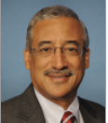

H.R. 842/S. 420 – Protecting the Right to Organize Act of 2021 (PRO Act)
Bill sponsors
Background
116th Congress: Passed House on 2/6/2020, but did not pass the Republican-controlled Senate
Has largely Democratic support: Of the 213 cosponsors, 210 are Democrats and 3 are Republicans
Many Republicans and key business groups oppose the bill
Sen. Patty Murray (D-WA) introduced a companion in the Senate
Outlook
The PRO Act is unlikely to pass in the Senate due to the filibuster and a slim Democratic majority
To pass the bill and avoid a filibuster, every Senate Democrat and 10 Republicans must support the bill
Though unlikely to pass in its current form, future legislation may include certain elements of the PRO Act
Rep. Robert Scott
D-VA-3
Sen. Patty Murray
D-WA
Status
Introduced: Senate
2/24/21
Passed Senate
Differences resolved
Signed by president
H.R. 842/S. 420
Introduced: House 2/4/21
Passed House 3/9/21
Tribal Labor Sovereignty Act

Slide 15
Political Forecast

Slide 16
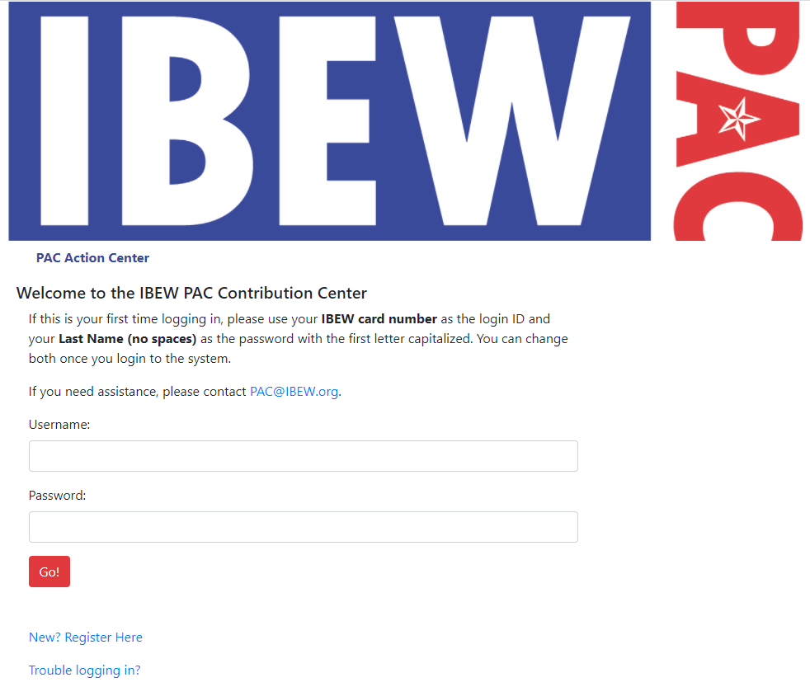

IBEW PAC Website
www.ibew.org/ibewpac/contribute
or
Scan the QR Code below with your phone camera

Slide 17
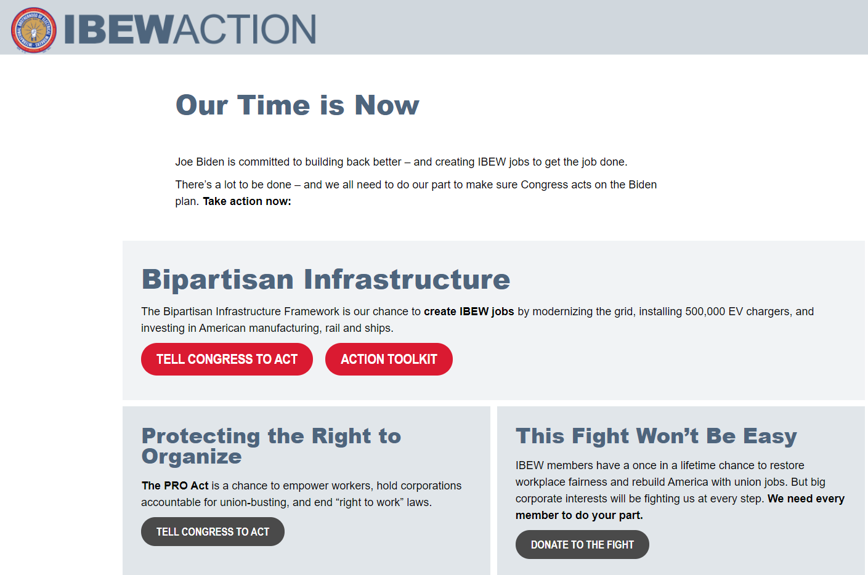
IBEW Action Website
https://ibewaction.org/

Slide 18
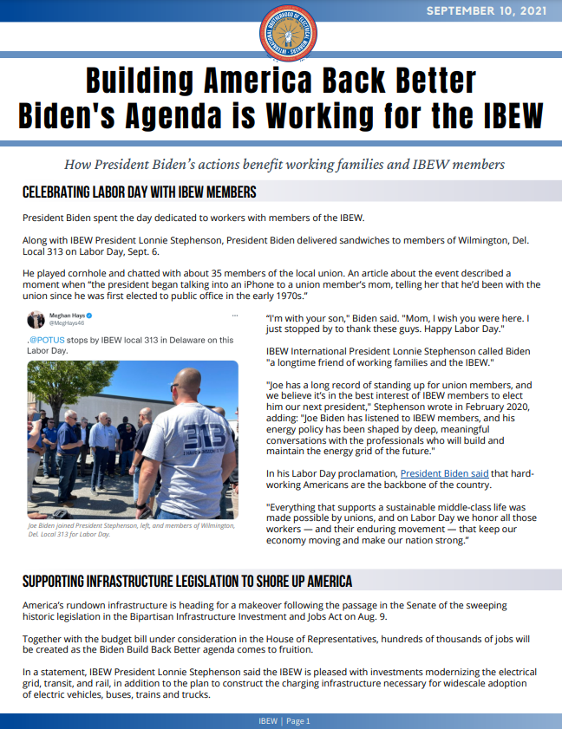
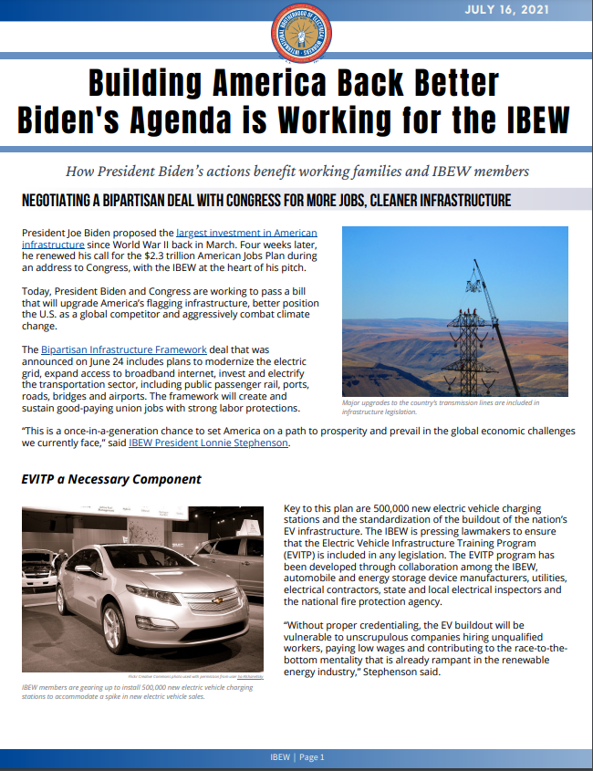
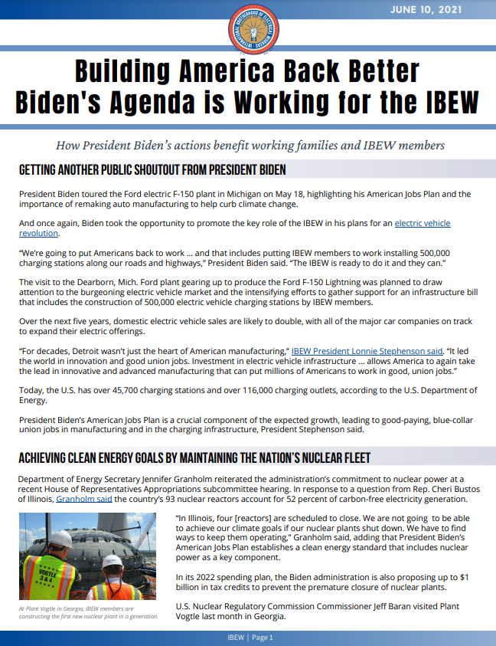
Political Newsletter
visit http://www.ibew.org/political/bbb
or
email governmentaffairs@ibew.org
to sign up for our monthly newsletter

Slide 19
Contact Us
Government Affairs Department
900 7th Street NW
Washington, DC 20001
Phone: (202) 728-6046
Email: governmentaffairs@ibew.org

